Slide 1
ONLINE CRIME REPORTING SYSTEM
It’s our pride to serve you!
Project by : Salini Vinekari A58
Prachi Palande A40

Slide 2
Table of Content
1
2
Abstract
Existing system
3
4
Proposed system
Technology
Idea of the project.
One look at old system.
We have better solution.
Building the best with…

Slide 3
Table of Content
5
6
Modules
Diagrams
7
8
Output screens
Conclusions
Accessibilities
ERD-DFD-UML
Glances of our project
All summarised

Slide 4
1. ABSTRACT
The purpose of Online Crime Reporting System is to automate the existing manual system by the help of computerized equipment and full-fledged computer software, fulfilling their requirements, so that their valuable data/information can be stored for a longer period with easy accessing and manipulation of the same. The required software and hardware are easily available and easy to work with.

Slide 5
2. Existing system
In the existing system most of the operations are done manually like filing complaints, taking actions against crimes. With existing system, if anybody wants to complaint against crimes, he must do it through the police/ police station. Currently there is no online web application available to report crime online. In order to report any complains related with crime, people has to contact nearest police station. People of the particular city are not aware of crime related things such as list of Most wanted criminals of their city, latest crime related news, missing persons of their area etc.. People has to view News Channels or Read News Paper for such crime related information. Thus, we can say that existing system is manual and does not provide all the information from one source.

Slide 6
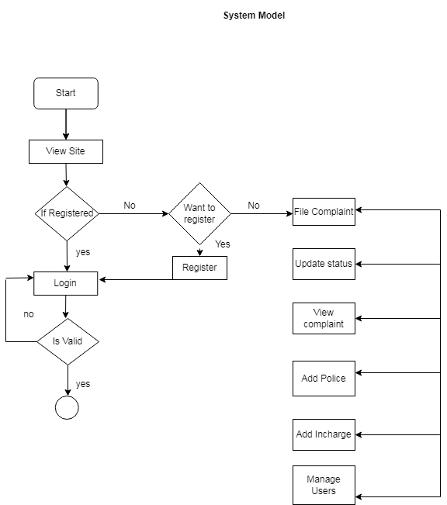
3. Proposed system

Slide 7
Advantages
Unique
Wide range of unique technology and globalisation.
Reduced Crimes
Since it gives access to every corner of the world.
copyright
It allows HeadQuarters to retain their full copyright.
Risks
Almost all risks are under control
Security
Data is decentralized.
Fraud
It is completely authentic.

Slide 8
4. Technology – Software
Software
Back –end
WAMP SERVER
PHP MYSQL DATABASE
Operating system
Front-end
Windows 7& above
HTML CSS JAVASCRIPT

Slide 9
4. Technology – Hardware
Processor
RAM
Intel core i5 2GHz
4 GB or more
Monitor
Keyboard & mouse
LCD monitor
Normal and compatible

Slide 10
5.Modules
User module
Admin module
Add/Delete/Display Incharge
Display/Delete User
Display/Delete Complaint Status
Registration
Login
Add Complaint
View Complaint Status
Police
INCHARGE
View Complaint
Update Status
Maintain Records
View Complaint
Add/Delete Police

Slide 11
6
Diagrams
ERD-DFD-UML

Slide 12
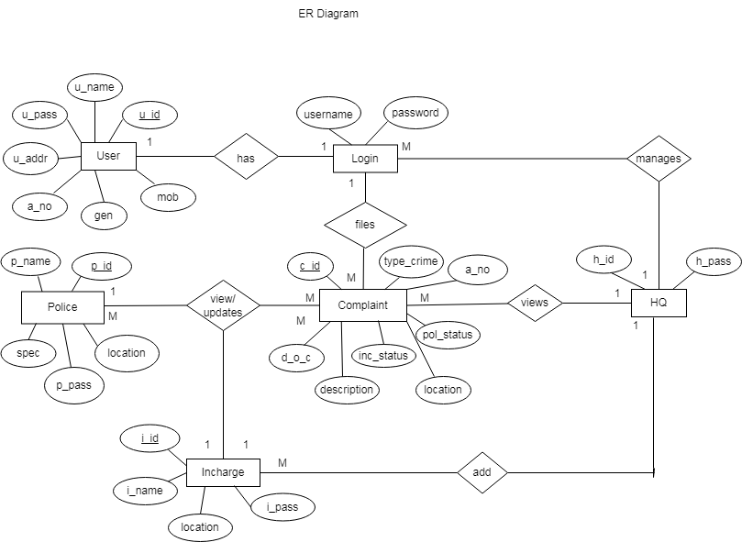
ERD

Slide 13
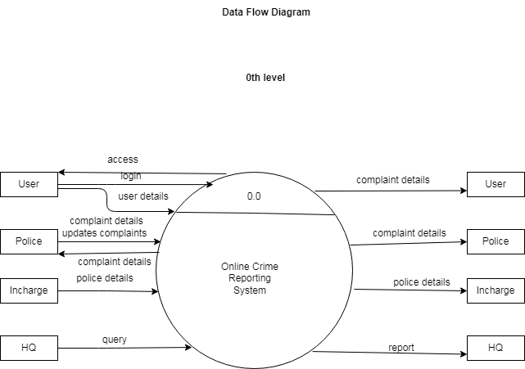
DFD – 0TH LEVEL

Slide 14
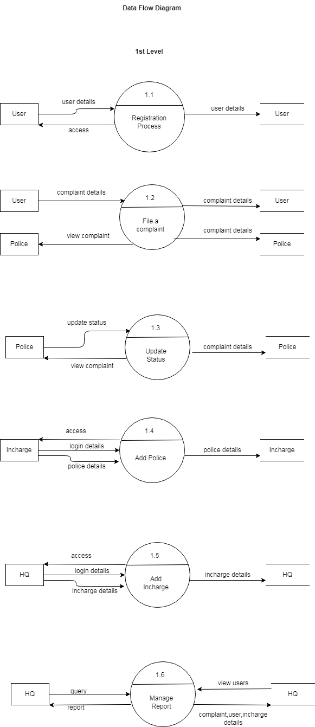
DFD

Slide 15
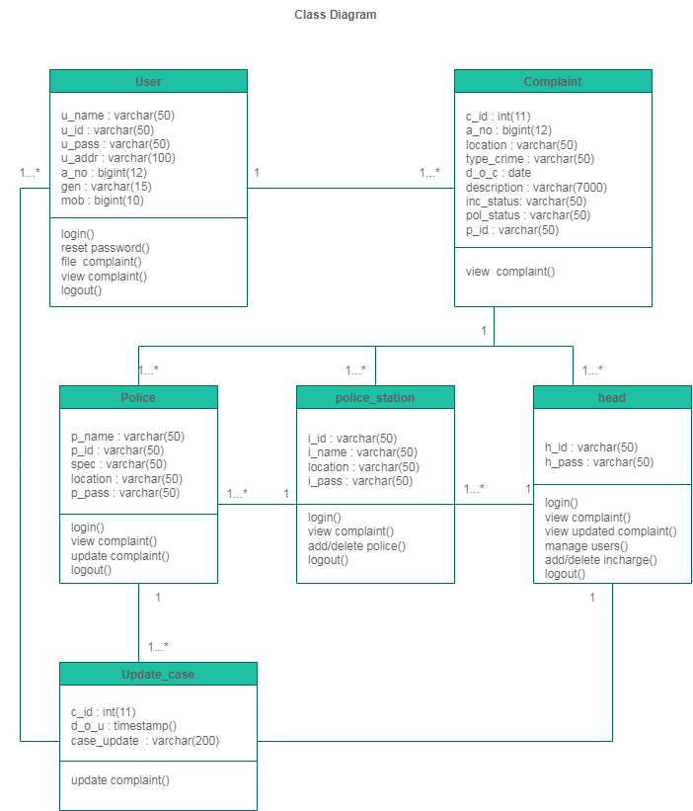
UML –CLASS DIAGRAM

Slide 16
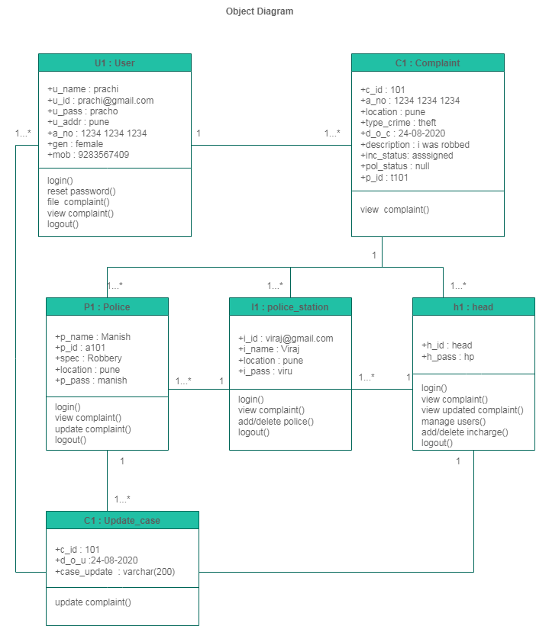
UML –OBJECT DIAGRAM

Slide 17
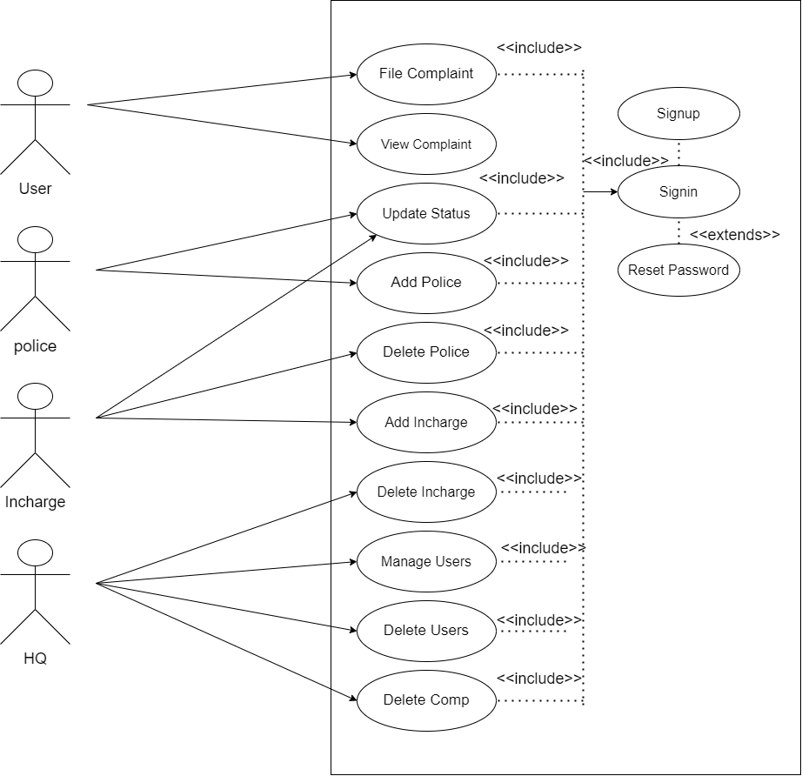
UML –USE CASE DIAGRAM

Slide 18
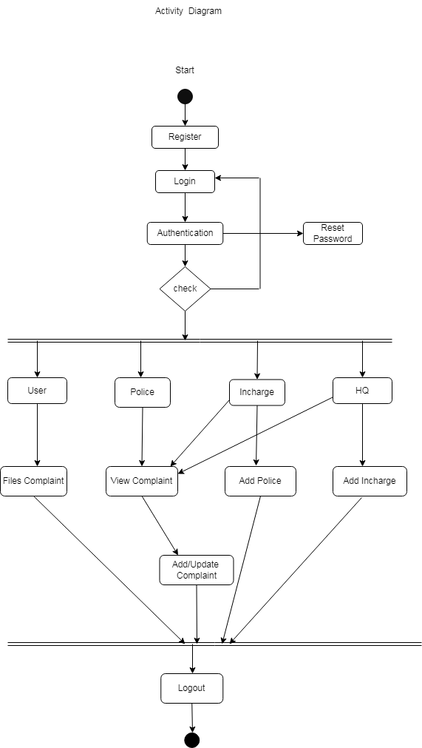
UML –ACTIVITY DIAGRAM

Slide 19
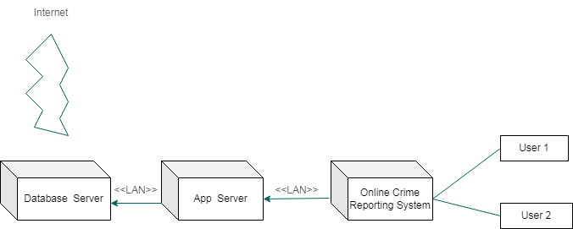
Deployment Diagram

Slide 20
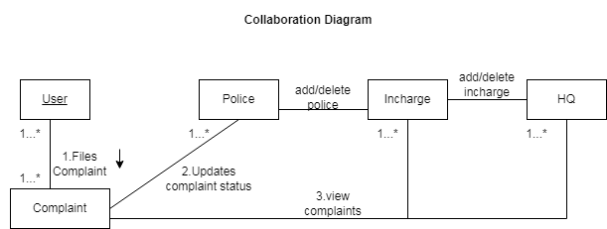
Collaboration Diagram

Slide 21
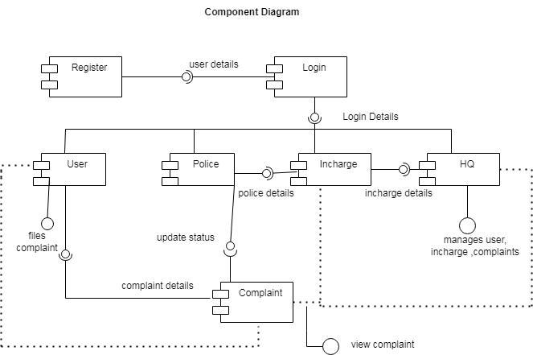
Component Diagram

Slide 22
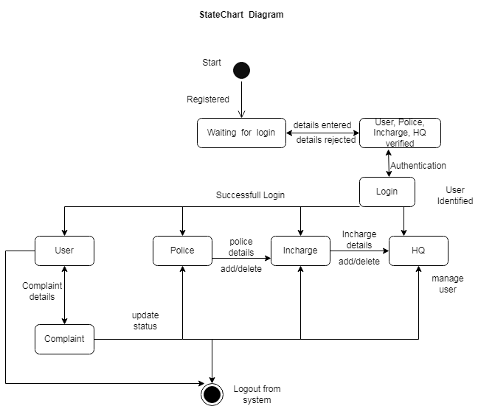
StateChart Diagram

Slide 23
7 OUTPUT SCREENS

Slide 24
8.Conclusion
In the modern world, the use of computers and Mobile phones are becoming rampant. More so, recent developments in ICT Industries has revolutionized and consequently brought about a paradigm shift in the way activities are accomplished. As a result of the crime reporting system needs to embrace these new technologies. This report has presented a simple, convenient, cost-effective, but efficient online crime reporting system with a user-friendly, sensitive and intelligible web interface. Whereby it can be accessed at any time provided there is an internet connection.

